Slide 1



Slide 2
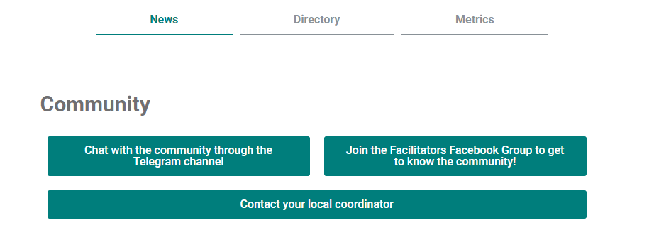
Community page
In the community page you will find Telegram Channel to communicate with community & a Facebook Group with the community.
You will also be able to contact your local coordinator

Slide 3
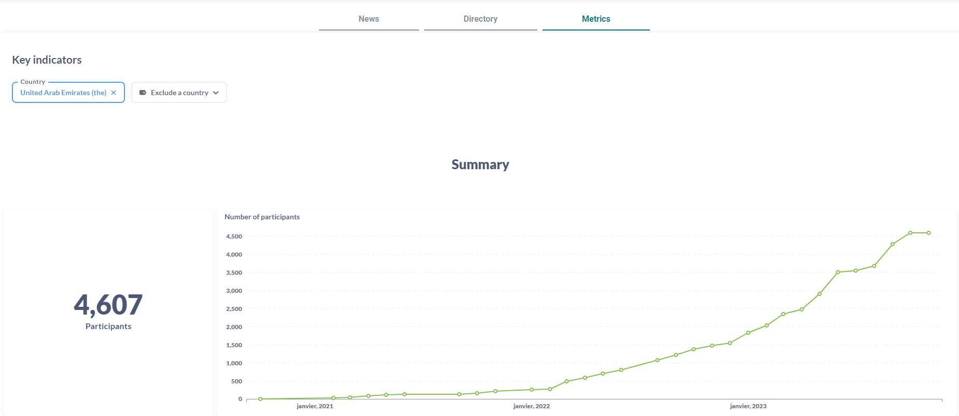
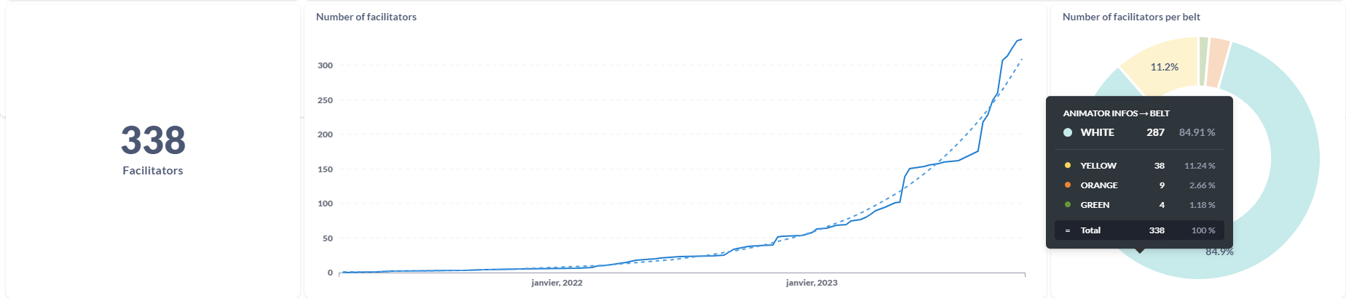
Community page
Metrics will show you the indicators. From how many Participants & Facilitators.

Slide 4
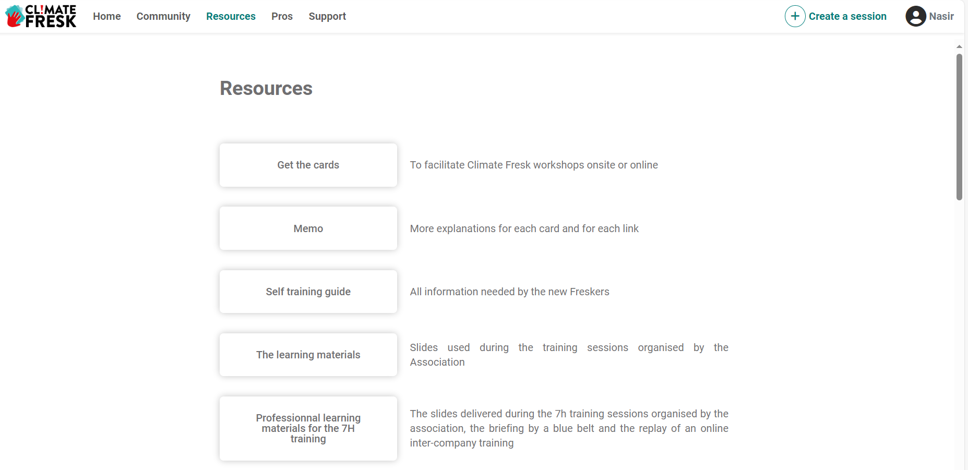
Resources page
In the Resources page you will find material and extra explanations for the workshop

Slide 5
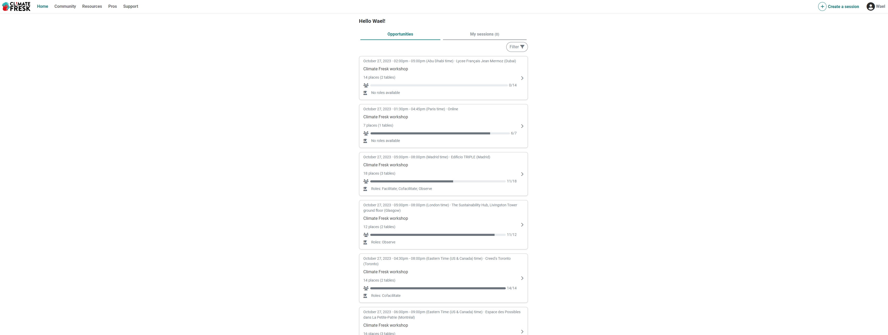

Creating a session - Step 1
Once you're in the home page you will see on the far right a plus sign and it says Create a session, click on it

Slide 6
Creating a session - Step 2
Select if the session in the past or upcoming

Slide 7
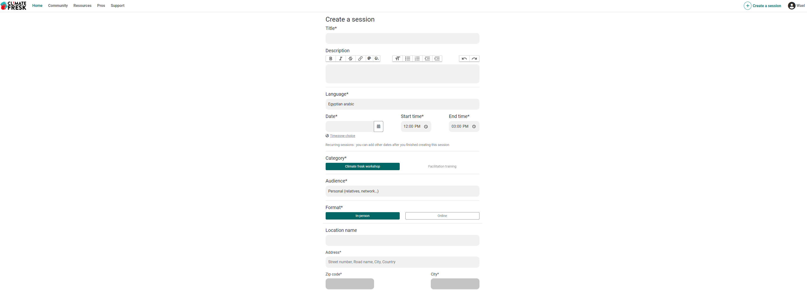
Creating a session - Step 3
Now adding the details of the session. * Required means that you have to insert a text

Slide 8
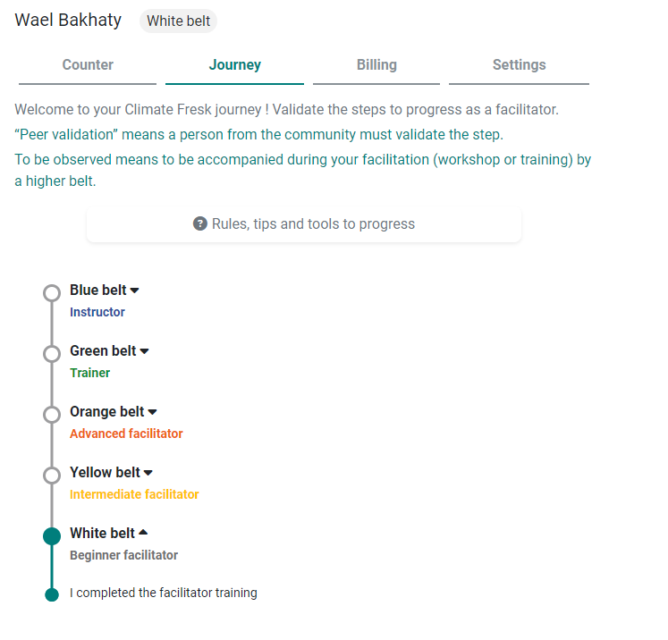
Your Journey as a facilitator
Once you complete your Train the Trainer you will be in the White Belt

Slide 9
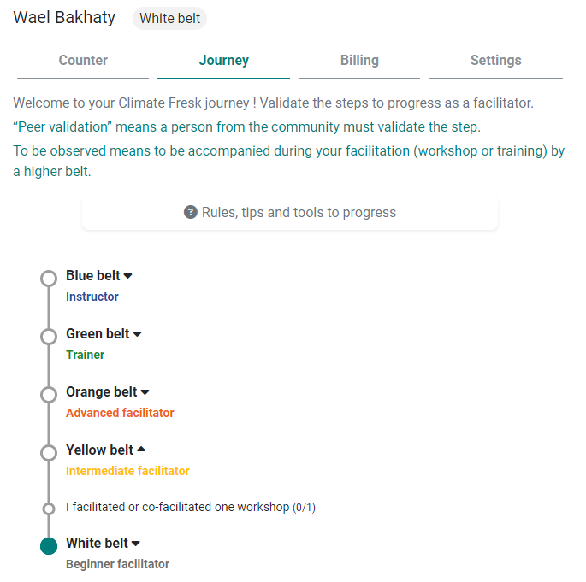
Your Journey as a facilitator
Complete one workshop and you will become Yellow belt

Slide 10
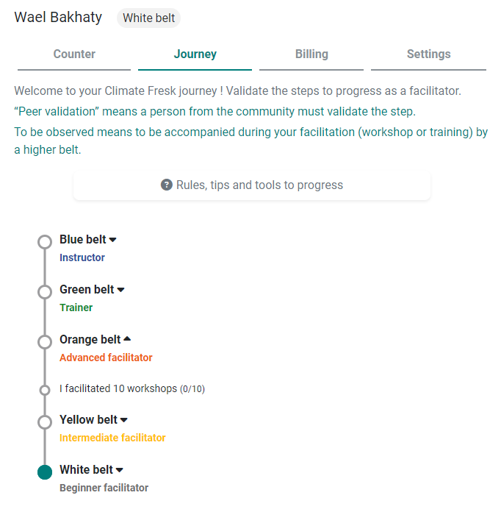
Your Journey as a facilitator
Complete ten workshop and you will become Orange belt

Slide 11
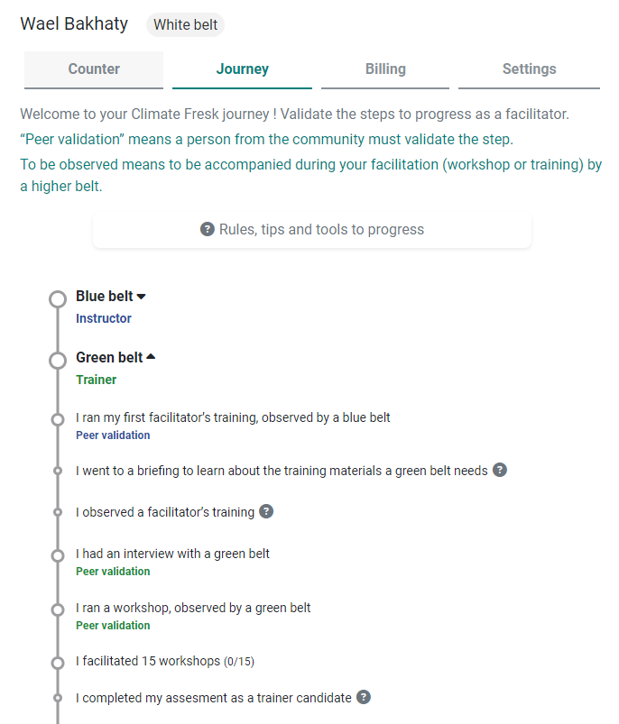
Your Journey as a facilitator
Complete assessment as a trainer candidate + facilitate 15 workshops, observed by a green belt, interview with a green belt, observed a facilitators training, learning the training materials a green belt needs, and you run a training observed by a blue belt and you will become Green belt

Slide 12
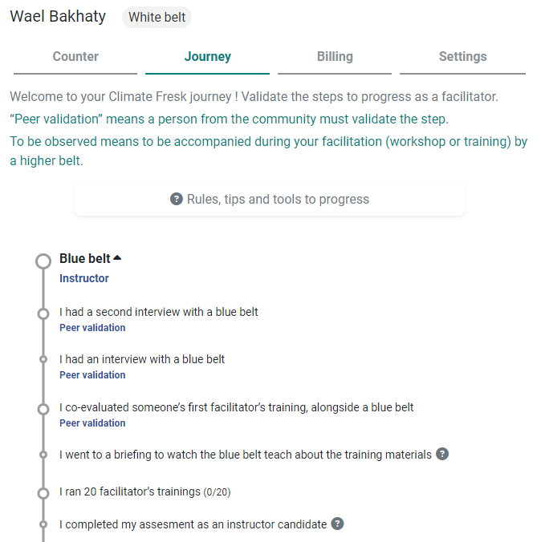
Your Journey as a facilitator
Complete assessment as an instructor and run 20 facilitator’s trainings, watch the blue belt teach about the training materials, co-evaluate someone first facilitator training alongside a blue belt, have two interviews with a blue belt and you will become Blue belt

